Slide 1
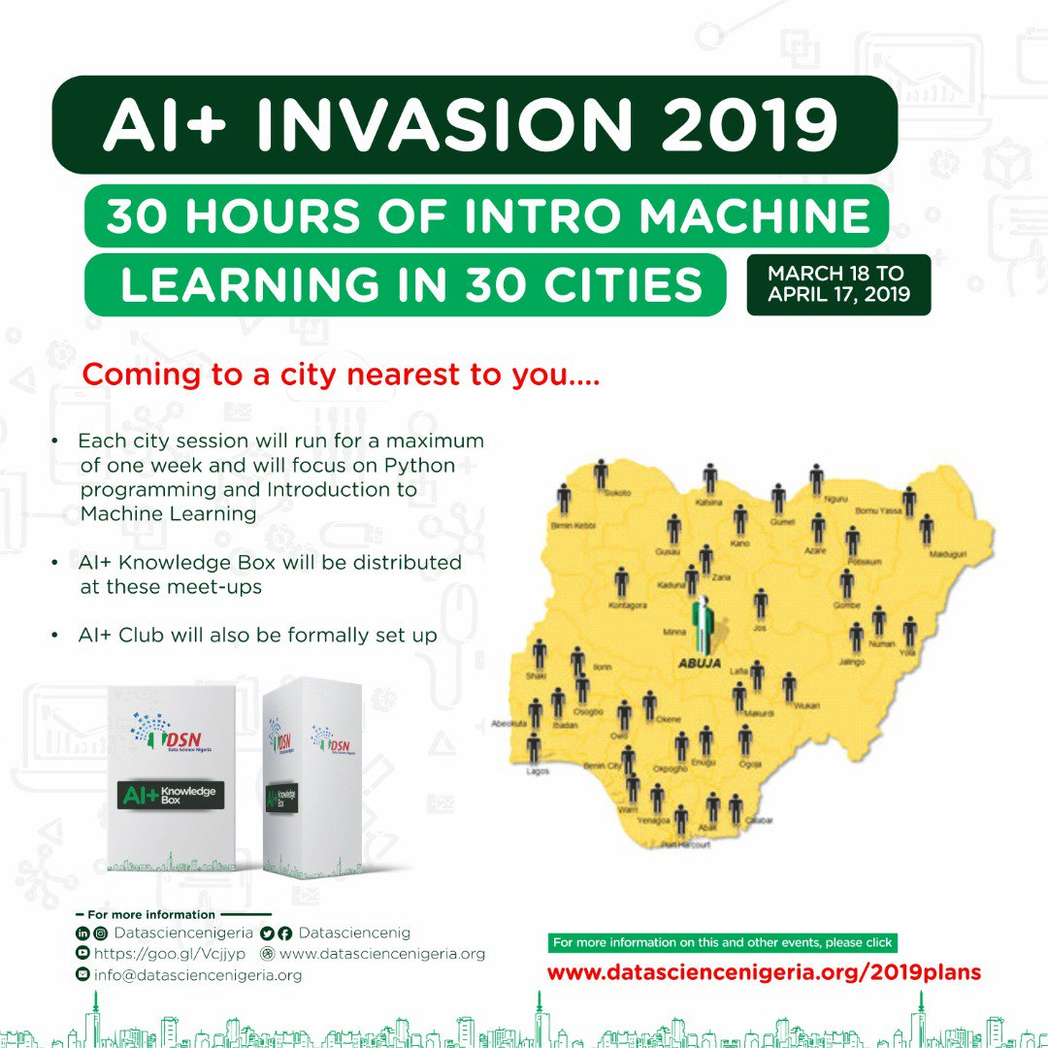
Lagos City AI-INVASION 2019
A 5 day Introduction to Python and Machine Learning

Slide 2


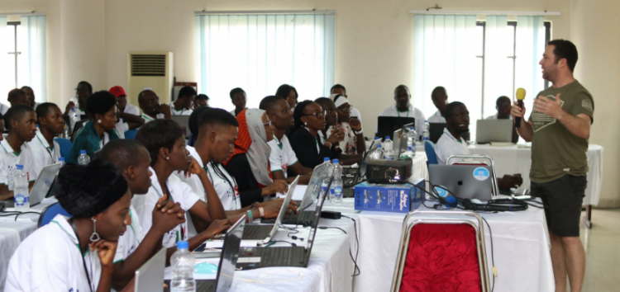
About Data Science Nigeria
Data Science Nigeria is a non-profit driven by a vision to build a world-class Artificial Intelligence knowledge, research and innovation ecosystem that delivers high impact research, business use applications, locally-relevant AI-first start-ups, increase employability and drive for social good use cases.
FOUNDED BY
DR BAYO ADEKANMBI
CTO MTN NIGERIA

Slide 3

ADESIJI BLESSING
TUTOR
DATA ENTHUSIAST
PETROLEUM ENGINEERING GRADUATE, UNIVERSITY OF IBADAN
Email: blessingadesiji96@gmail.com
Twitter: AdesijiBlessing
Linkedln: Adesiji Blessing
Instagram: bleso_a
Kaggle: kaggle.com/abtoye
Zindi: https://zindi.africa/users/AdesijiBlessing_DSN

Slide 4
Overview
Introduction to Regression Analysis
Introduction to Machine Learning Part 1
Regression and Classification Comparison
01
03
05
02
04
06
Introduction to Machine Learning Part 2
Assumptions of Regression and Tree-based Regression Model

Slide 5
Day 1 - Introduction to Machine Learning Part 1
What is Machine Learning?
But What does it does actually or why do we need ML or AI?
Types of Machine Learning Algorithms
Jupyter Notebooks

Slide 6

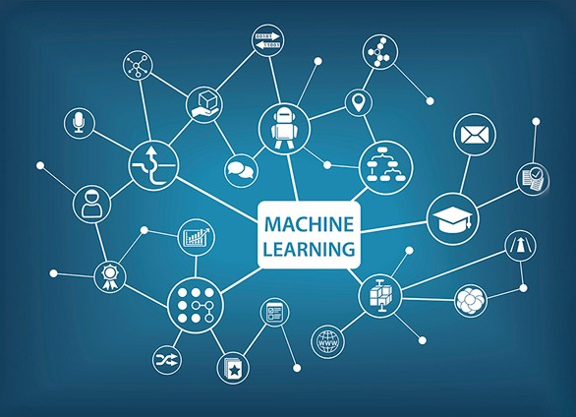
What is Machine Learning?
Machine learning is a method of data analysis that automates analytical model building. Using algorithms that iteratively learn from data, machine learning allows computers to find hidden insights without being explicitly programmed where to look.
It’s not like that, Machine learning or ML and Artificial Intelligence or AI are the same. There are a lot of differences as well a lot of similarities. Alternatively, we can also say that, Machine learning is a component of AI.

Slide 7
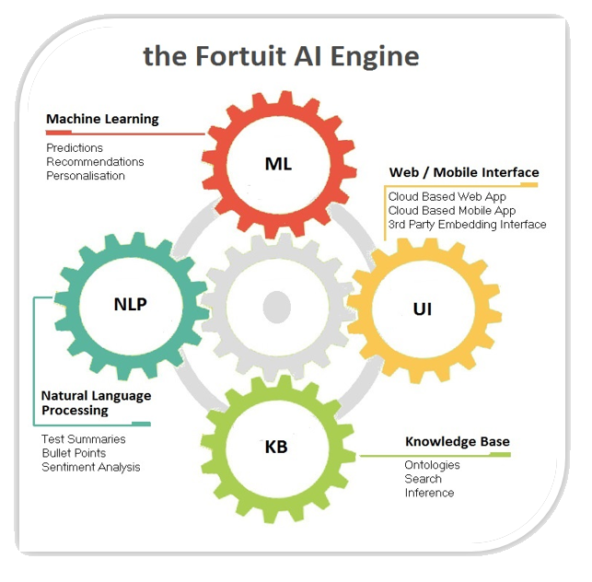
What is AI?

Slide 8
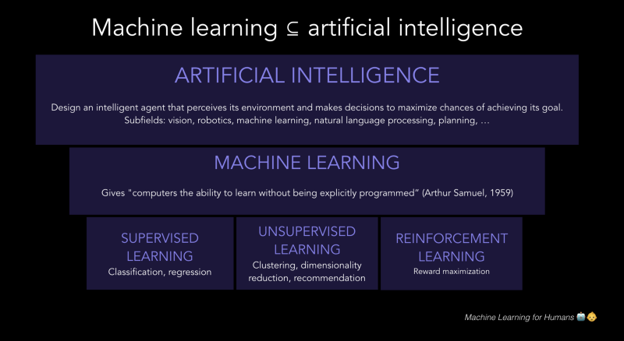

Slide 9
Trad Programming VS ML
Traditional Programming
Machine Learning
Data
Computer
Output
Program
Data
Computer
Program
Output

Slide 10

Machine Learning’s full component

Slide 11

Magic?
No, more like gardening
Seeds = Algorithms
Nutrients = Data
Gardener = You
Plants = Programs

Slide 12

What does it actually do or why do we need ML or AI?
● Fraud detection.
● Web search results.
● Real-time ads on web pages
● Credit scoring and next-best offers.
● Prediction of equipment failures.
● New pricing models.
● Network intrusion detection.
● Recommendation Engines
● Customer Segmentation
● Text Sentiment Analysis
● Predicting Customer Churn
● Pattern and image recognition.
● Email spam filtering.
● Financial Modeling
Where Traditional programming fails.
Where rules cannot be written down explicitly.

Slide 13




Applications of Machine Learning
Online Fraud Detection
PayPal.
It uses machine learning to stand in defense against illegal acts like money laundering. By comparing millions of transactions, it can find out which ones are illegitimate.
Virtual Personal Assistant
Siri and Alexa
We can ask Siri to make a call for you or play music. You can request Alexa for today’s weather forecast. You can even set an alarm or send an SMS.
Social Media Services
Uses machine learning to monitor your activity- what profiles you visit, which people to send requests to, which ones you accept requests of, the people you tag, among much more
Research and develop diagnostics and therapeutic treatments.

Slide 14


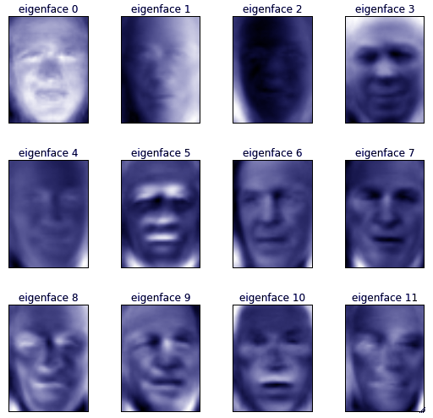



Many email clients use rule-based spam filtering. Gmail use machine learning to keep their spam filters updated. Common spam-filtering techniques are Multi-Layer Perceptron and C 4.5 Decision Tree Induction.
Products Recommendation
Jumia, Amazon notice what products you look at and suggest similar products to you.
Facilities like face detection are often something we see with Facebook. When we want to tag a photo, Facebook automatically suggests us a few names. Most of the times, the first name is accurate for the face it has detected.
Entertainments
Spotify, Apple Music, Genius
Source: https://data-flair.training/blogs/applications-of-machine-learning/

Slide 15
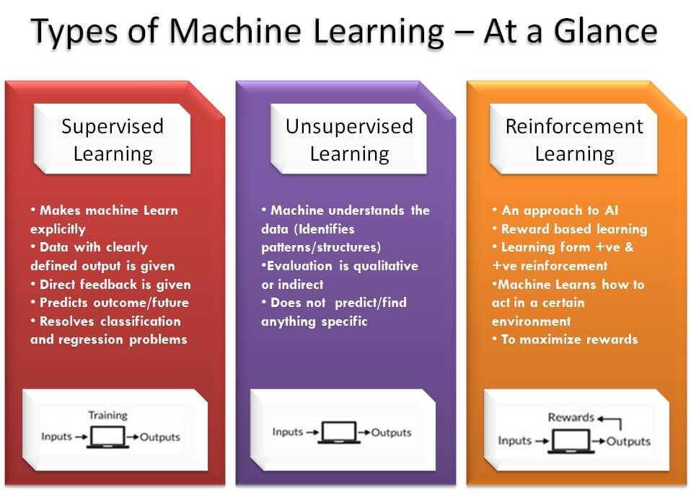

Slide 16
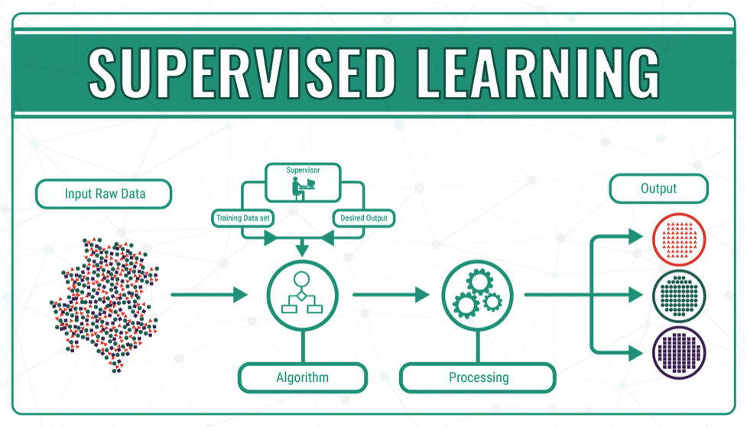

Slide 17

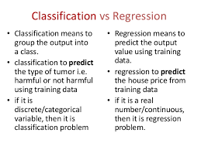
Supervised Learning

Slide 18


Slide 19
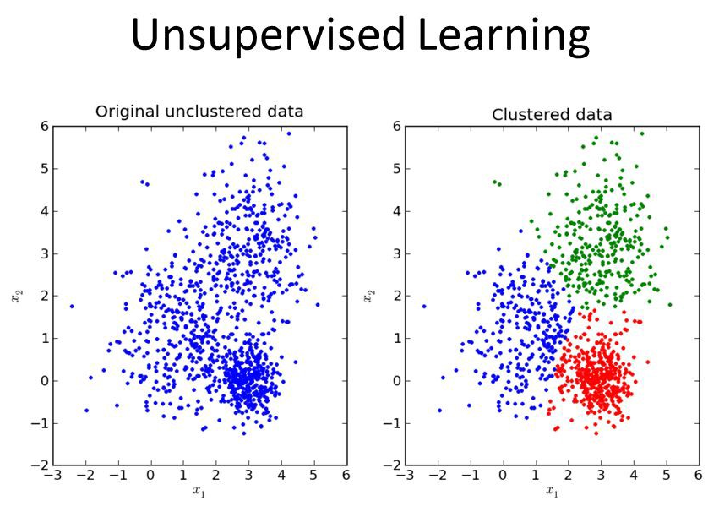
Examples
An advertising platform segments the U.S. population into smaller groups with similar demographics and purchasing habits so that advertisers can reach their target market with relevant ads.
Airbnb groups its housing listings into neighborhoods so that users can navigate listings more easily.
A data science team reduces the number of dimensions in a large data set to simplify modeling and reduce file size.

Slide 20
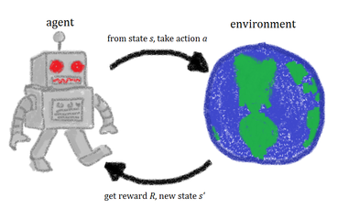
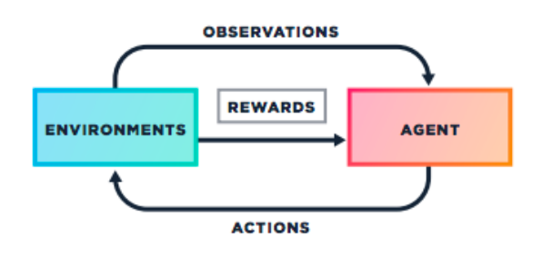
Reinforcement Learning
Find the best possible behavior or path it should take in a specific situation.
In reinforcement learning, there is no answer but the reinforcement agent decides what to do to perform the given task.
In the absence of training dataset, it is bound to learn from its experience.

Slide 21
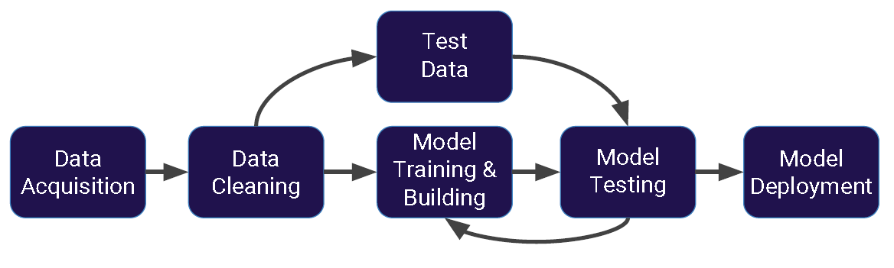
Machine Learning Process

Slide 22
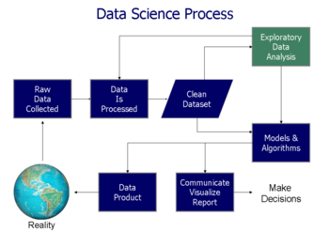
Data Analysis
Data Analysis is the process of systematically applying statistical and/or logical techniques to describe and illustrate, condense and recap, and evaluate data.
Techniques of Data Analysis:
Data Mining (Predictive Data Analysis)
Business Intelligence (Actionable Business Information)
Data Visualization (Representation of Data)

Slide 23
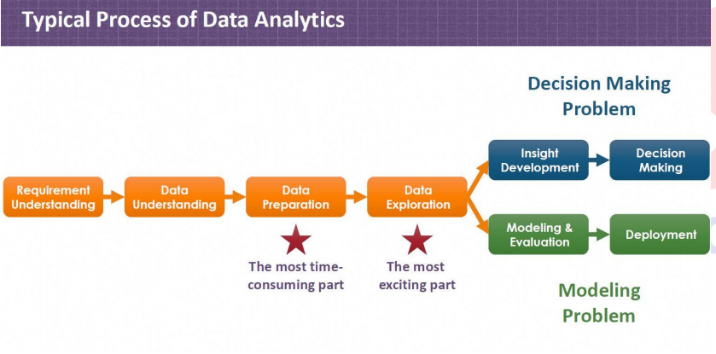

Slide 24
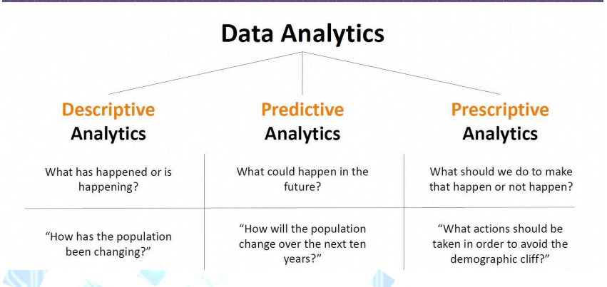
TYPES OF DATA ANALYTICS

